Slide 1
OOD CM2601 [Des]
What is Systems Analysis?
Content created by Guhanathan Poravi

Slide 2
Contents
What is systems analysis?
What is a system?
What is information?
What is an information system?
What knowledge and skills does a systems analyst need?

Slide 3
By the end of this module, you should be able to:
Know
Know what systems analysis is
Define
Be aware of the systemic/systematic divide
Define
Be able to define a system in terms of its components, connections and purpose
Define
Be able to define information and information system

Slide 4
What is systems analysis
The start of the systems development process
A way to understand a problem before you solve it
Modelling
A way to understand (and communicate) what a client wants to be done
Requirements Elicitation and Specification
Before the programming

Slide 5
Why do we need it (systems analysis?)
Software is not visualisable
it involves converting an idea or concept into a (slightly) more concrete artefact (i.e. program code)
This can involve many stages and personnel
The potential for mis-translation is huge
Large software systems are complex systems

Slide 6
We really need this because...
Many studies have been done on software development
No matter who does the work, the results tend to be the same
The key indicators of project success (and project failure if they are not) are:
User Involvement
Executive Management Support
Clear Statement of Requirements

Slide 7


When projects fail...
It’s not about the money lost or the time wasted; remember that software is everywhere
There is a well-documented case of a radiation machine overdosing patients
Details on the Therac-25 case can be found at: http://sunnyday.mit.edu/papers/therac.pdf
Also, the Ariane 5 rocket explosion
Lately, the FBI Virtual Case File system

Slide 8

Group Activity
Get into groups of 5
Carry out an investigation on information systems failures
Select a specific instance of such a failure and find,
What caused it?
What were the implications?
Were people affected?
Was money lost?

Slide 9
What is a System?
According to Oxford Advanced Learner's Dictionary
“ an organized set of ideas or theories or a particular way of doing something”

Slide 10
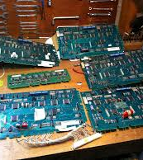
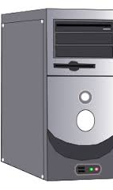
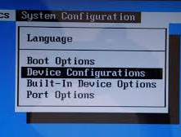
Examples of systems (Images from Google)

Slide 11
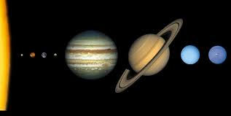
Examples of systems (Images from Google)

Slide 12
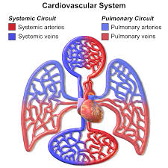
Examples of systems (Images from Google)

Slide 13
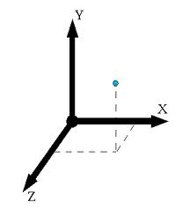
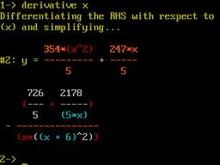
Examples of systems (Images from Google)

Slide 14
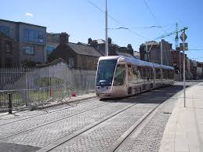
Examples of systems (Images from Google)

Slide 15
What is a system?
A set of components which are related in some way to function as a unit with a common purpose e.g.
A chair
The Milky Way galaxy
The education system
A web site
For any “system” we should be able to list the components, the connections and state the purpose
What are the components, connections and purpose of a football team?

Slide 16

What is a system?
Some interesting things about systems, they:
Are holistic
Are connected
Can be composed of other systems
Have emergent properties that are not properties of the components. Examples of systems with emergent properties are:
Water
The Human Body
Can you think of others?

Slide 17
What is information?
Information is any form of communication that provides understandable and useful knowledge to the person receiving it.
Behind the communication there is usually data which has been presented in a way which is (intended to be) meaningful to the beholder.

Slide 18
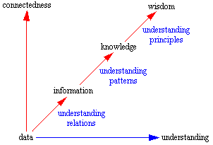
The DIKW structure (Bellinger et al., 2004: http://www.systems-thinking.org/dikw/dikw.htm)
Information is often represented on a continuum similar to

Slide 19

What is an information system?
An information system is a means of catering for the flow and storage of information to satisfy the requirements of all users. As well as storing data it typically generates, manipulates and communicates information.

Slide 20

Examples of information systems
CampusMoodle
A website
A payroll system
An order processing system
An expert system that diagnoses illnesses
Take two minutes and come up with three further examples

Slide 21
Components of an information system
Software
Hardware
People
Procedures/rules
Database
Documentation

Slide 22



What does a systems analyst do?
Translates users’ information needs…..
Programmers
Users
..into instructions for programmers to follow

Slide 23
What does a systems analyst do?
developing an information system
maintaining an
information
system
initial idea
for system
live system
Position the following:
meeting with users to discuss
Programming
brainstorming solutions
designing web pages
creating database design
documenting
programs and test cases
writing program specifications
testing programs
enhancing system
documenting the system for future use
training of users

Slide 24
What kinds of knowledge must a systems analyst have?
List as many as you can
Organise the list into categories or areas of knowledge
You have three minutes

Slide 25
Possible answers
Business knowledge
Computer or technical knowledge

Slide 26
What types of skill must a systems analyst have?
List as many as you can
Organise the list into categories or areas of skill
You have three minutes

Slide 27
Possible answers
Fact gathering skills
Analysis skills
Problem solving skills
Communication skills
People skills

Slide 28
Who does the systems analyst work with?
Project
Manager
Team
Members
IT
Management
Internal
Audit
Senior
Management
Systems
Analyst
Related Project
Managers
Clients
Users
Communications
Data
Management
Operations

Slide 29

Revision
Define the following terms:
Information
System
Information System
Systems Analysis
Human Activity System
Skill
Knowledge

Slide 30

Next
UML Designing for OOD
Use Case diagrams

